Slide 1
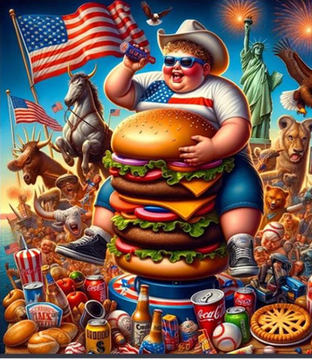
What are the socio-economic risk factors associated with obesity in the US?
A R-based data exploration by Salome Drouard

Slide 2
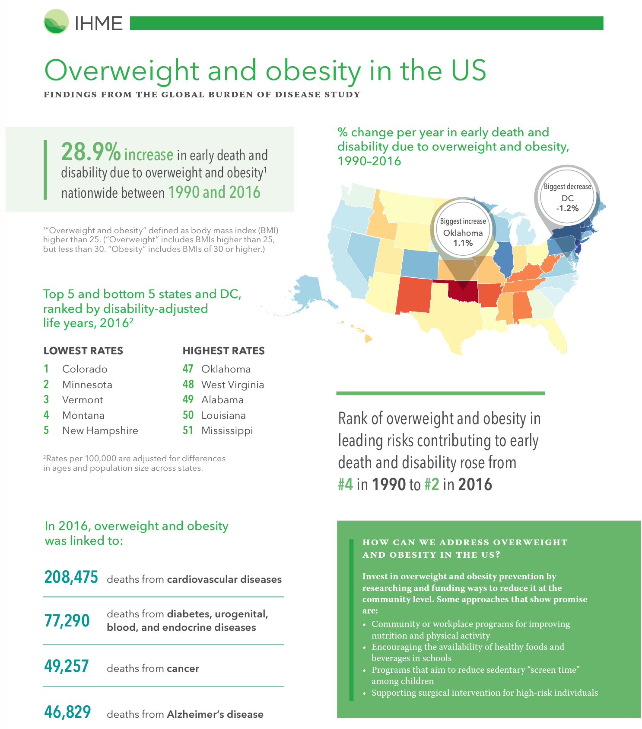
Background
Obesity is one of the leading cause of mortality and morbidity in the US.
Getting worse over time:
Over past 30 years, rose from the 4th to the 2nd cause of early death.
Evidence from literature:
Varies by race
Decreases with education and income
Affects women more
GBD 2013:
31.7% of men
33.9% of women

Slide 3

Data
National Health and Nutrition Examination Survey (NHANES) data:
the Centers for Disease Control and Prevention (publicly available)
the health and nutritional status of adults and children in the United States.
2017-2019 survey cycle.
Datasets:
socio-demographic: 9 254 observations
body measurement data: 8 597 observations
US non-pregnant adult population (age 20 and older): 5 210 observations
The full description of both datasets is available at: boy measurements and socio-demographic data .
Outcome variables:
Bmi: body mass index (weight in kilograms / height in meters squared)
Obesity binary: 1 for bmi >=30
Covariates:
Race:
Mexican American,
other Hispanic,
non-Hispanic white,
non-Hispanic black,
non-Hispanic Asian,
other or multi-racial
Sex:
female vs male
Age:
as a continuous variable
as 10-year age groups
Income quintile
Education:
Less than high school diploma
High school diploma
Some college or AA degree
College graduate or above

Slide 4
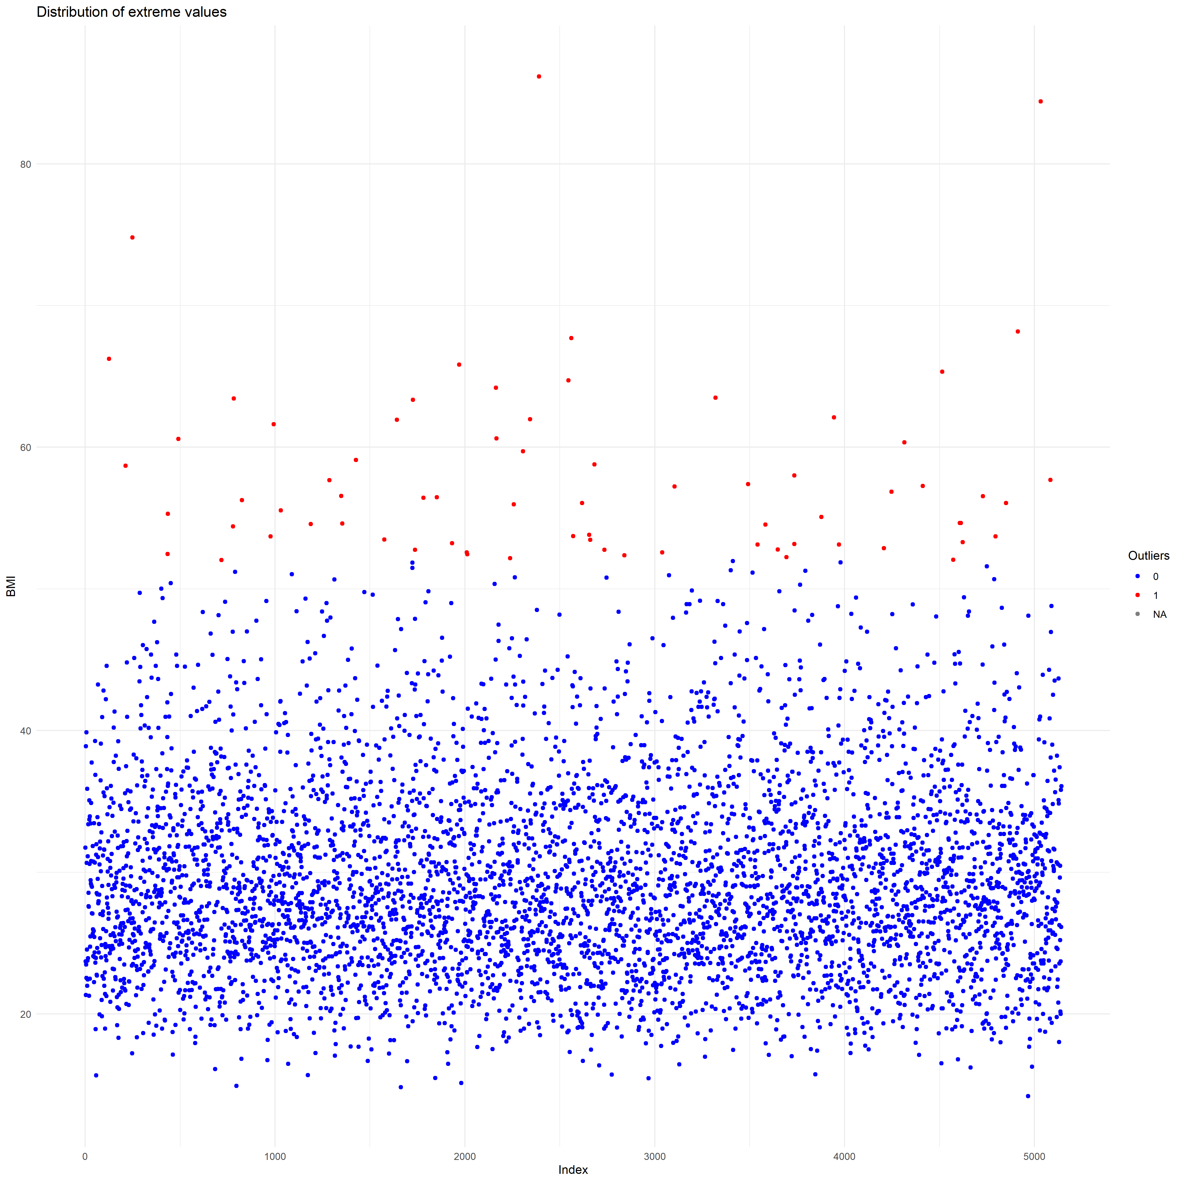
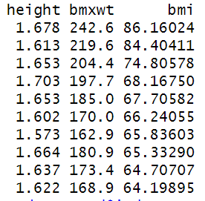
Extreme values
Disclaimer: not real outliers but we need missing data for the interpolation
More than 3 standard deviations away form the mean of bmi
72 extreme values
Replaced as missing in the bmi and obesity variable
Bmi and obesity: 162 missing values /5048

Slide 5
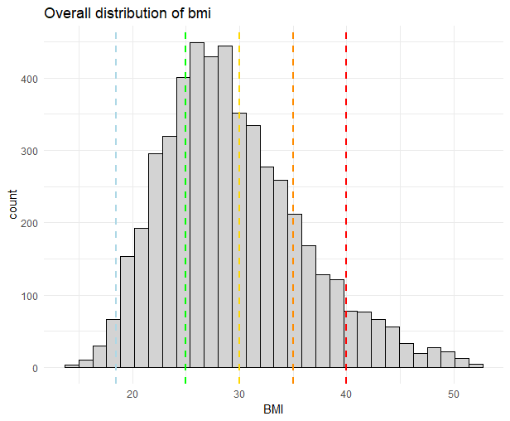
Bmi descriptive analysis and obesity prevalence
Mean bmi | Median bmi | 25th percentile | 75th percentile | Overall obesity prevalence
29.4 | 28.5 | 24.7 | 33.3 | 40.8
Definition | Bmi ranges | % US pop
Underweight | <18.5 | 1.6
Normal weight | 18.5-24.9 | 24.4
Overweight | 25.0-29.9 | 32.1
Obesity class 1 | 30.0-34.9 | 21.9
Obesity class 2 | 35.0-39.9 | 11
Obesity class 3 | >=40 | 7.7

Slide 6
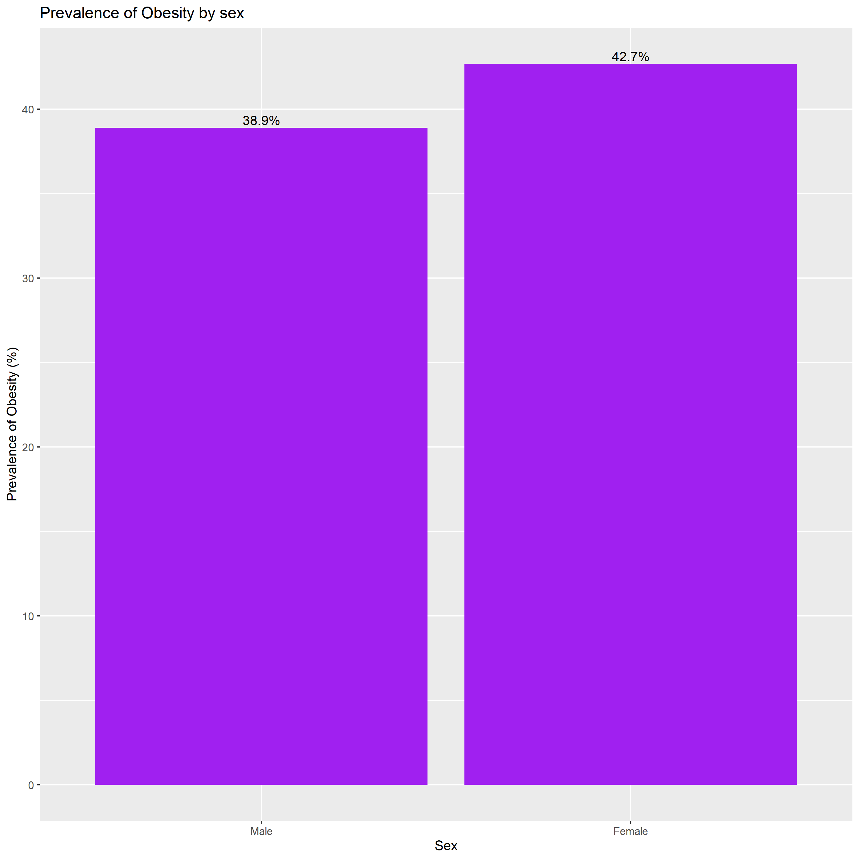
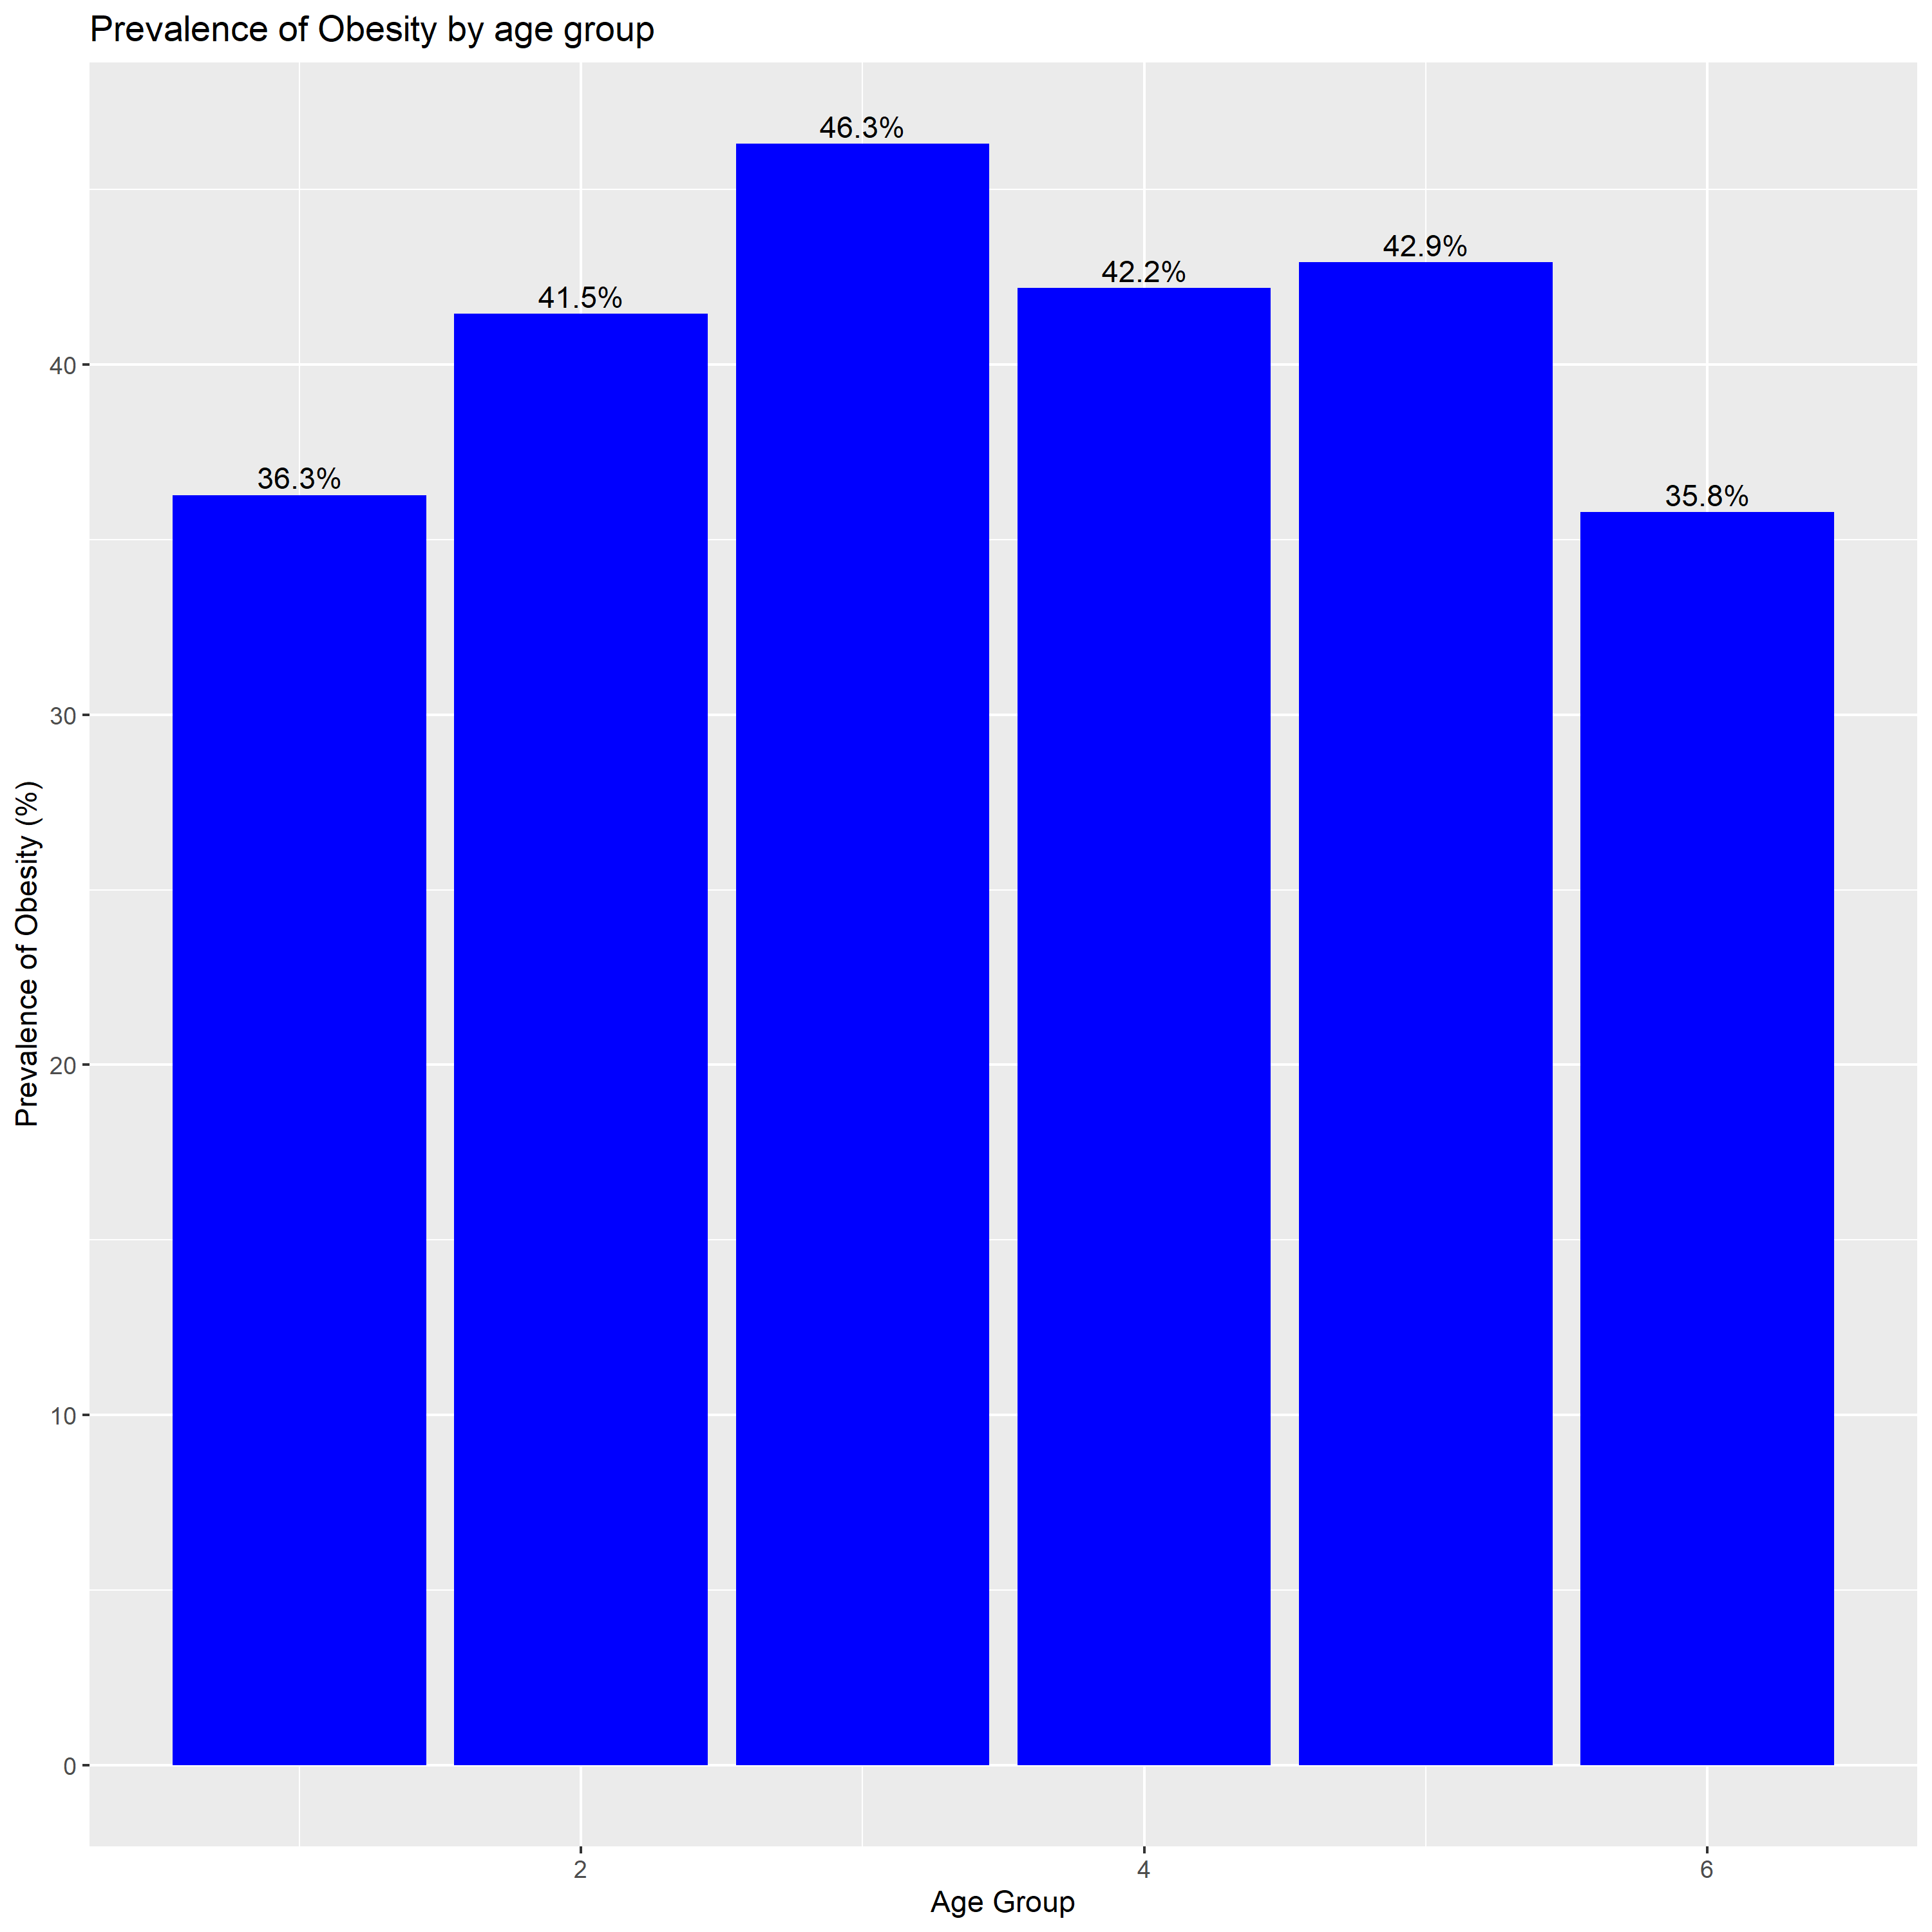
Obesity by covariate levels

Slide 7
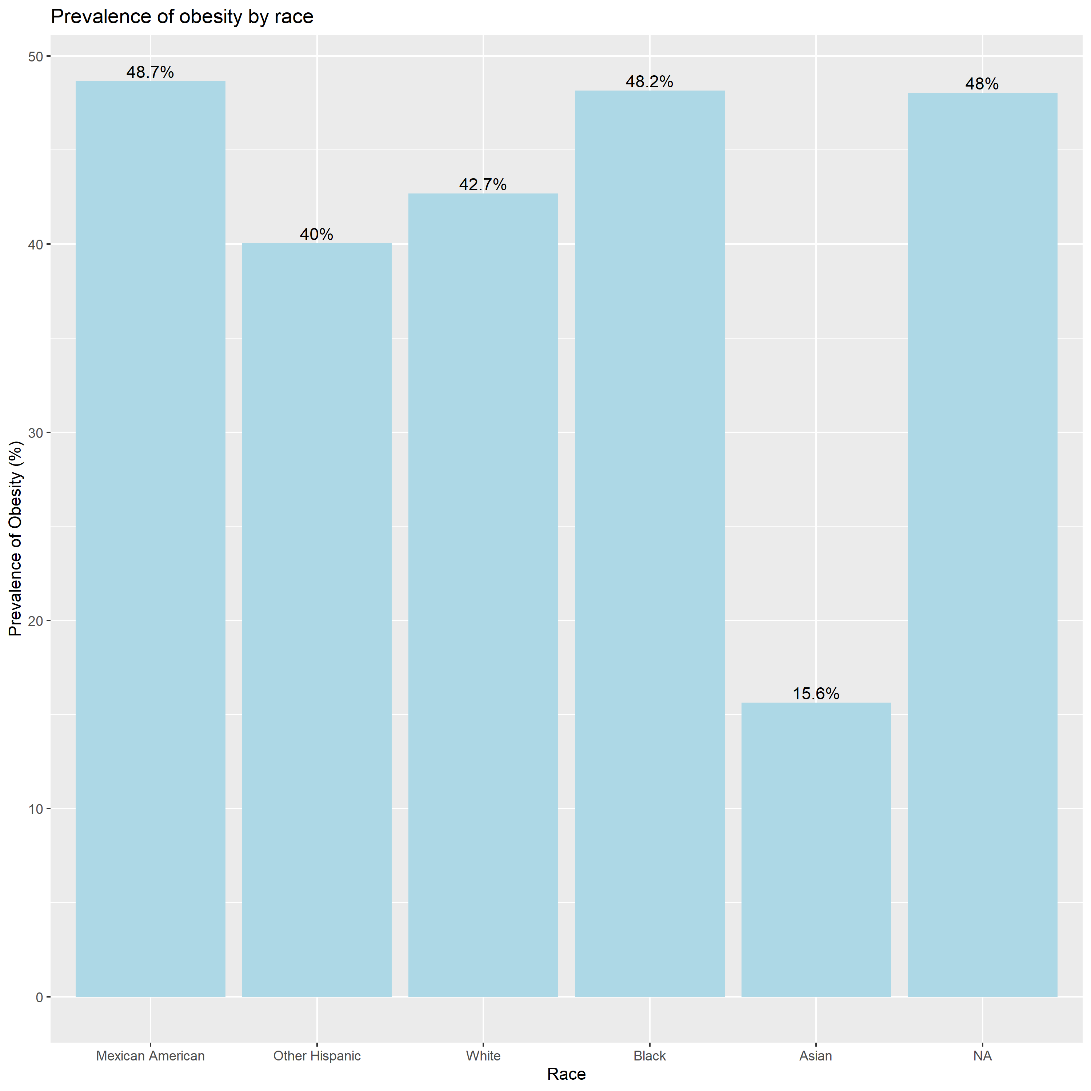
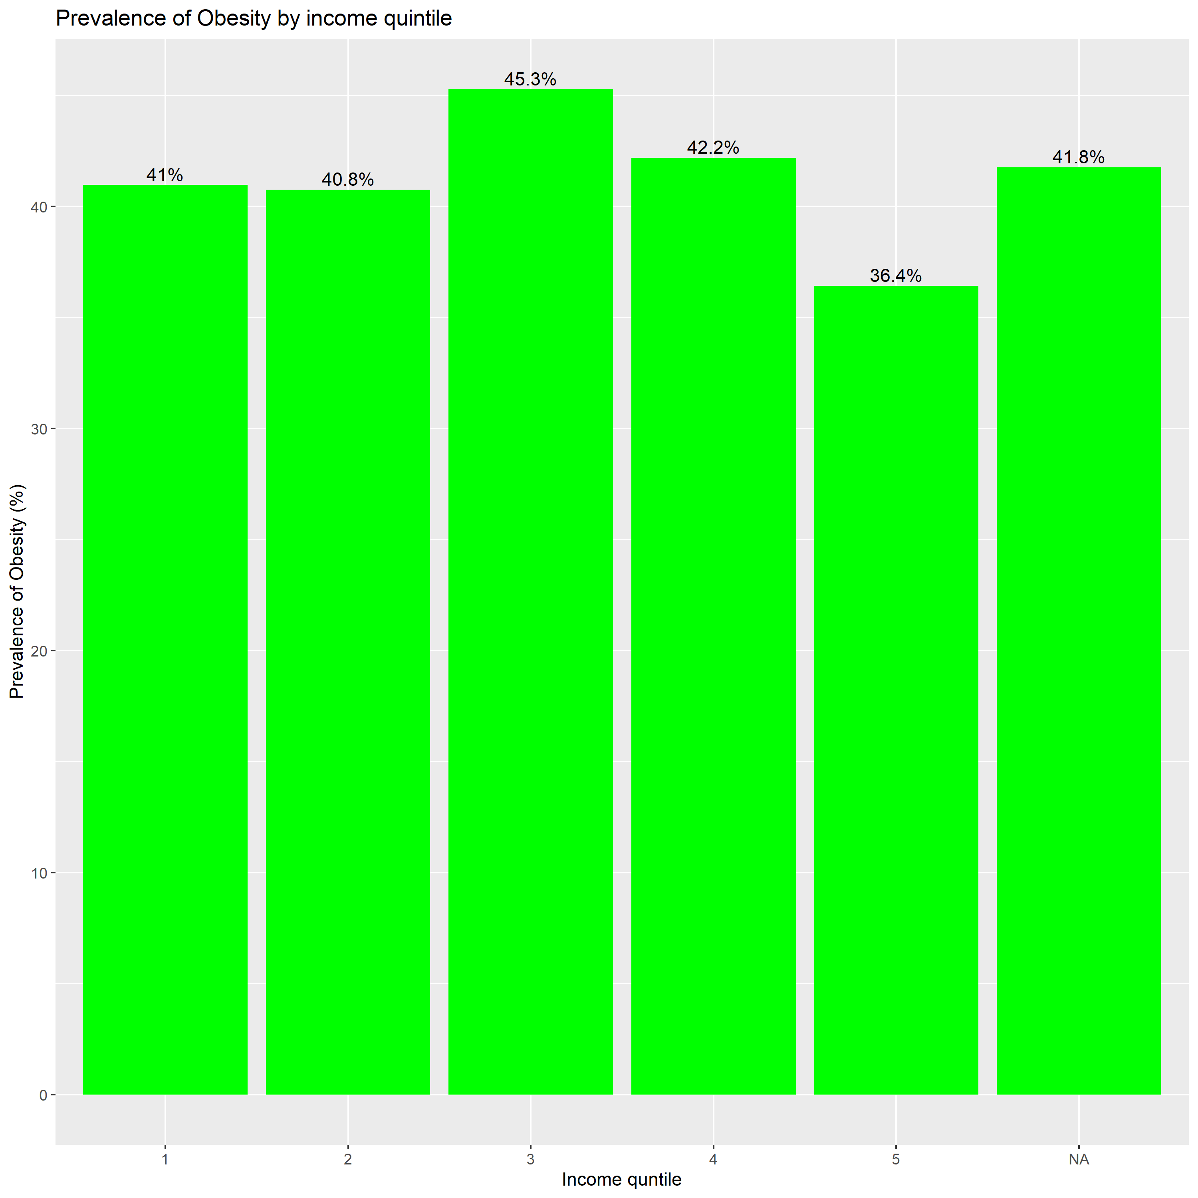
Obesity by covariate levels

Slide 8
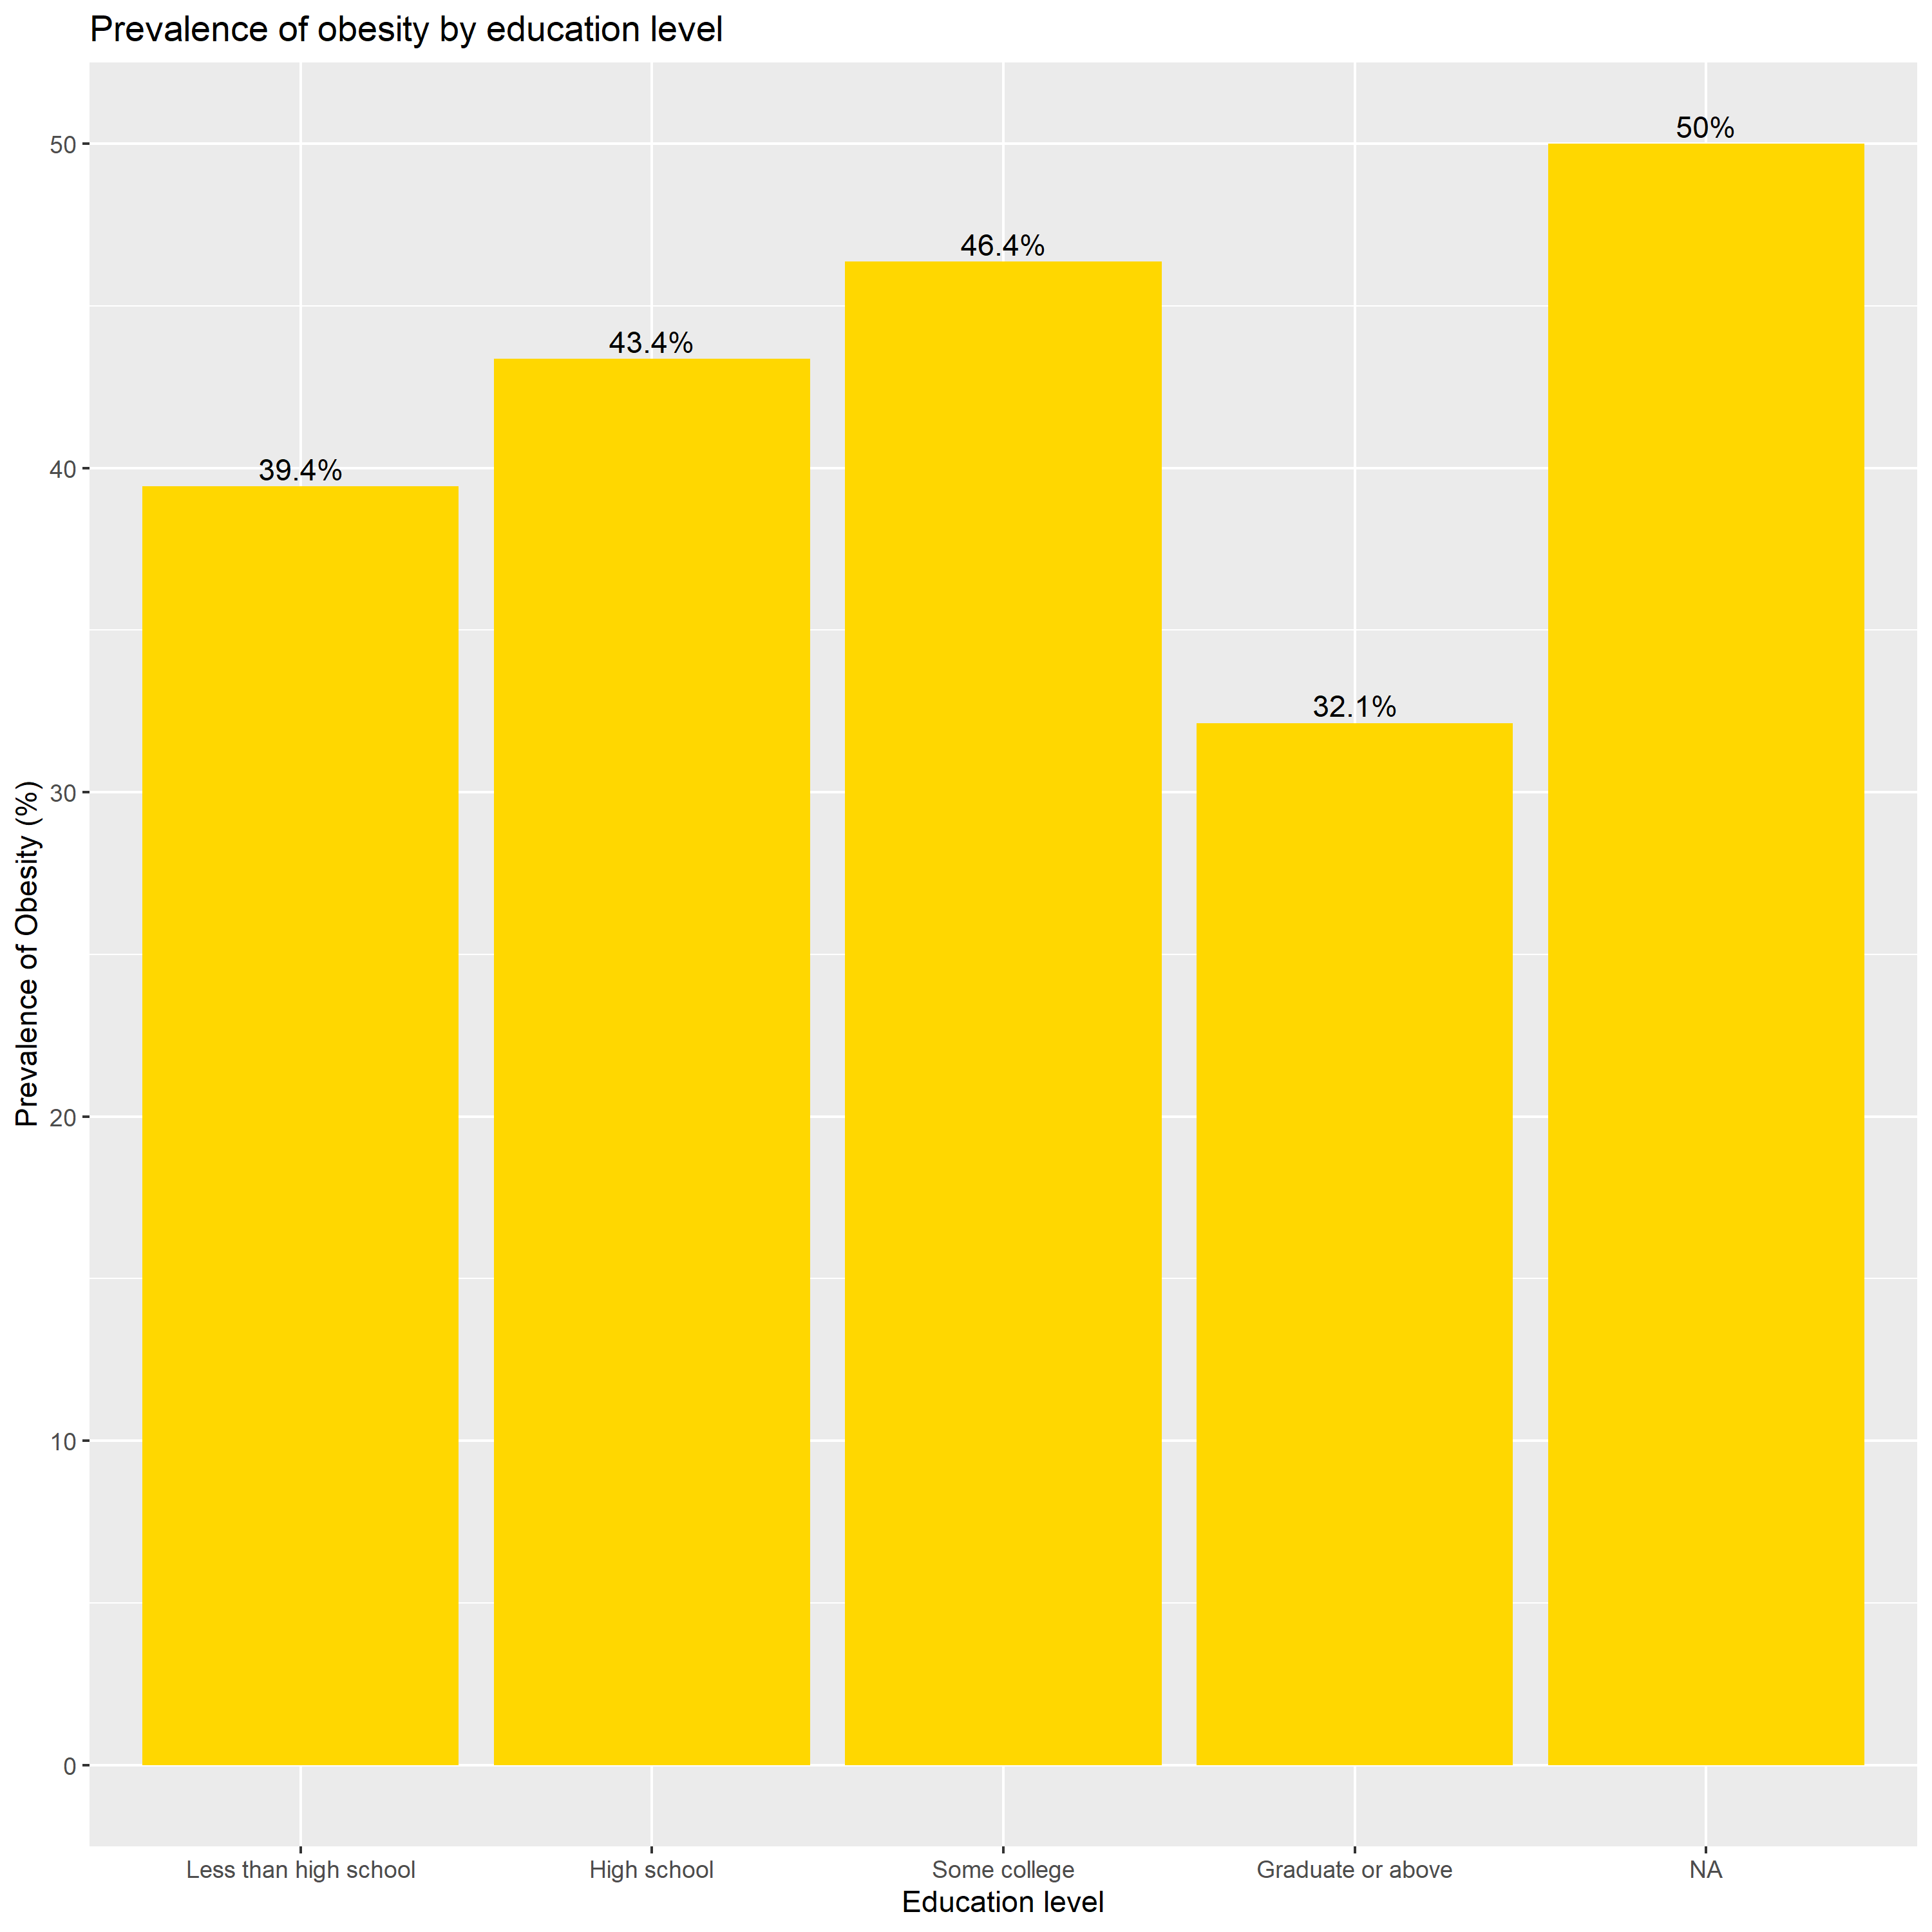
Obesity by covariate levels
Overall
Same trend for sex but higher magnitude!
Substantial variations by race
Not so sharp decrease in education and income
Nonlinear pattern for age

Slide 9
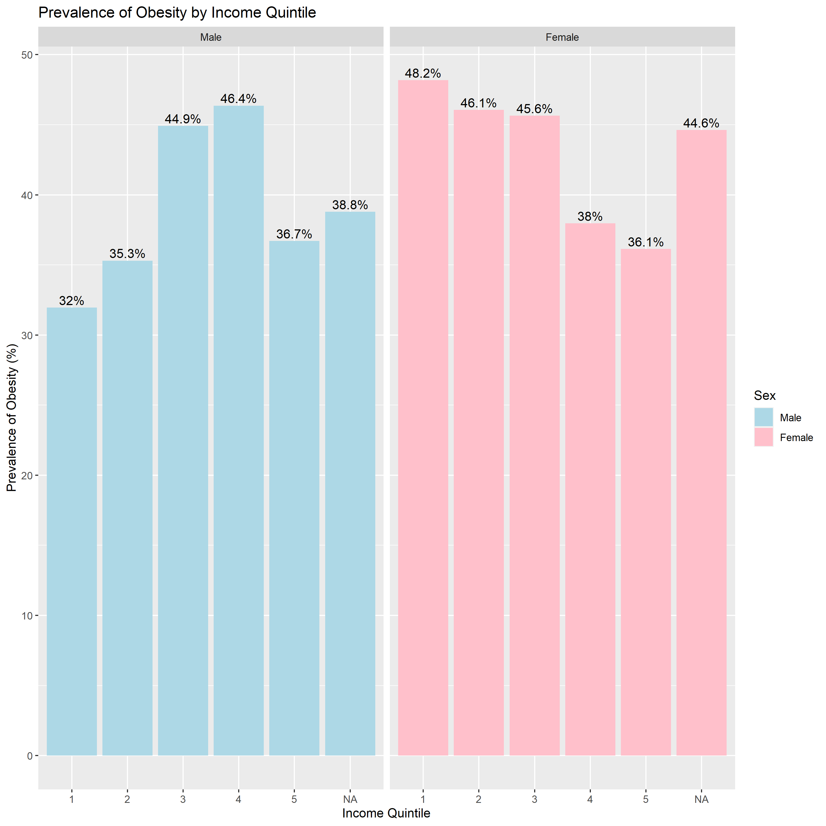
Obesity by income adjusting sex
Different association between obesity and income adjusting for sex
Negative relationship between obesity prevalence and income true for women … not so true for men
Nb: no obvious confounder for education

Slide 10
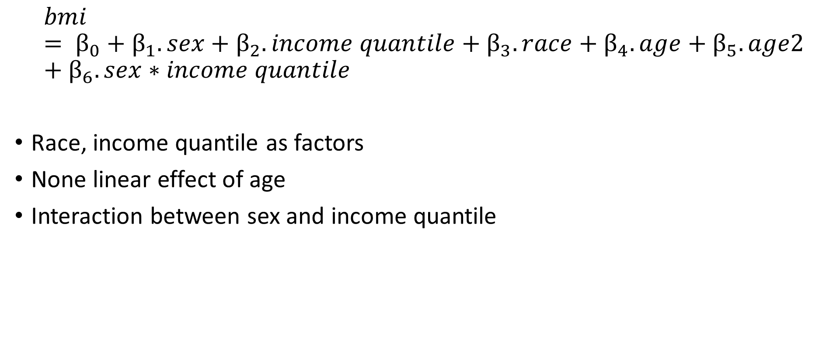
Linear regression specification
$$bmi= β_{0}+β_{1}.sex+β_{2}.income quantile+β_{3}. race+β_{4}.age+β_{5}. age2+β_{6}. sex∗income quantile$$
Race, income quantile as factors
None linear effect of age
Interaction between sex and income quantile

Slide 11
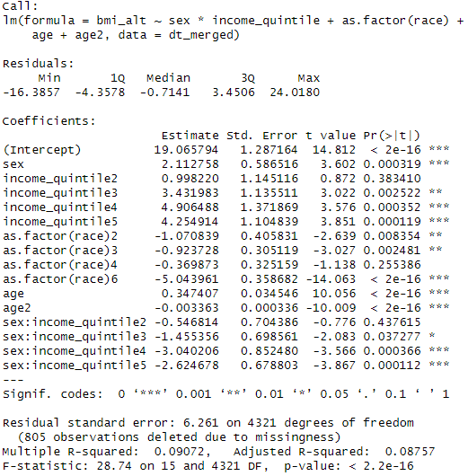
Linear regression result
Being a woman positively associated
Income positively associated
Race: omitted category is Mexican American
Interaction show the protective effect of income for women compared to men
Age turning point: 51-year-old
R2 …not amazing!

Slide 12
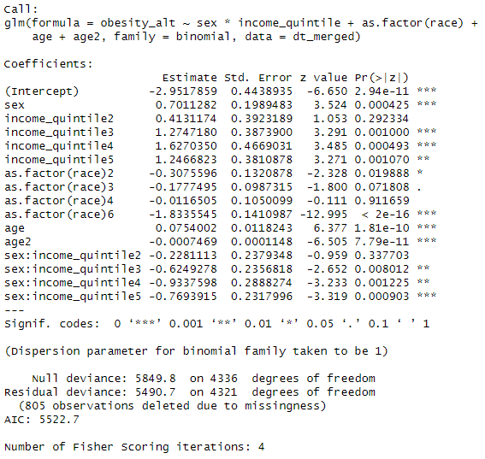
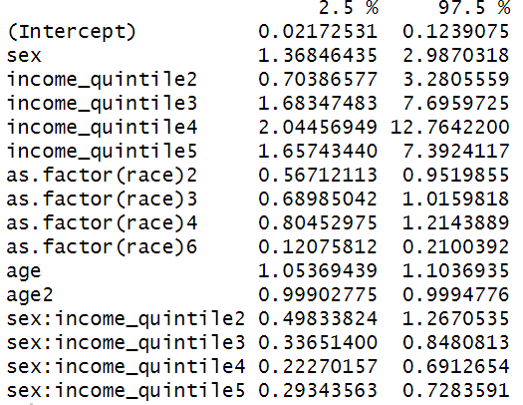
Logistic regression on obesity
Ok goodness to fit
Similar patterns as for bmi
…. But very large CIs!
95% Confidence intervals of odds ratios

Slide 13
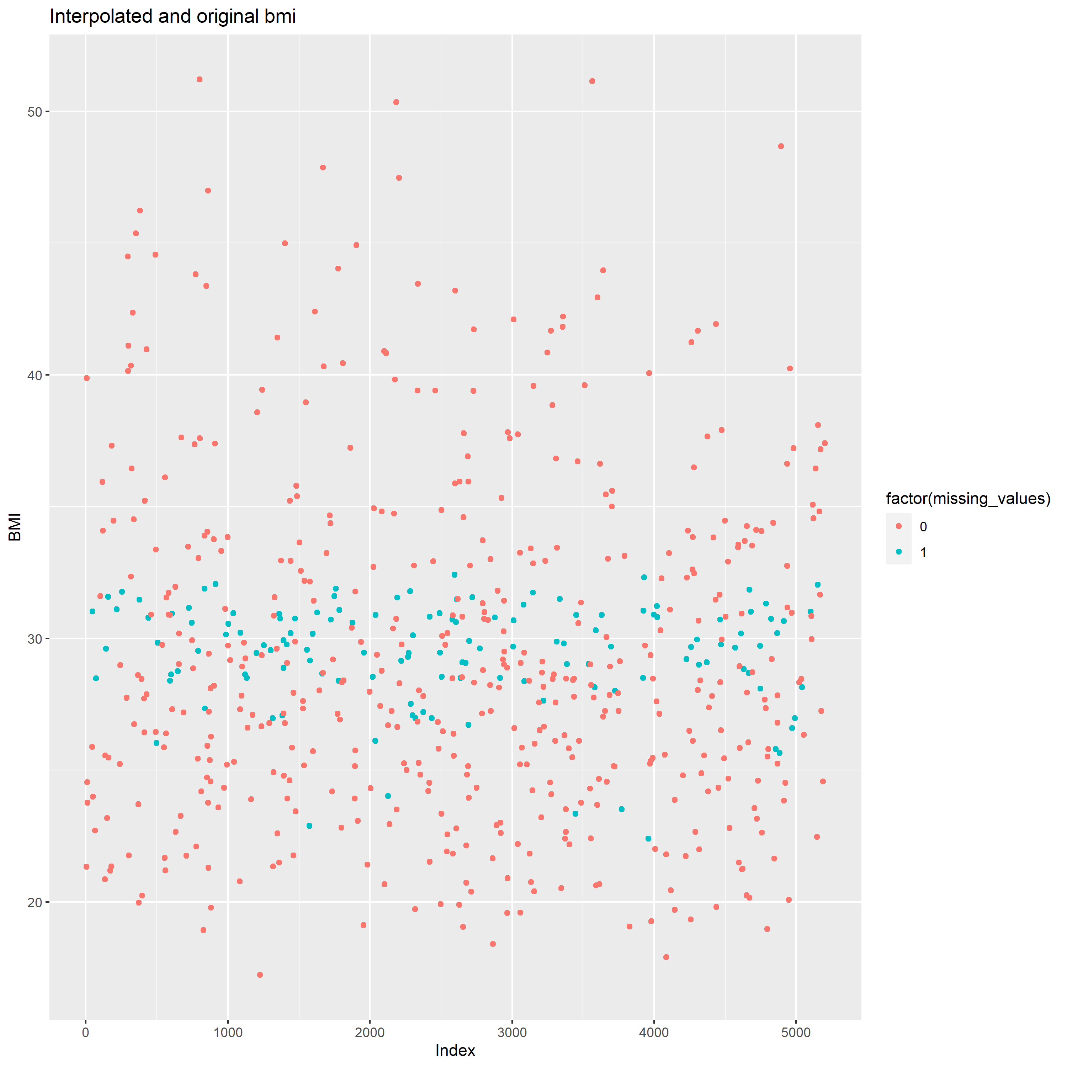
Diagnostic linear interpolation of missing values for bmi
Interpolation from the linear model
Not too bad … !

Slide 14
Predicting obesity: 2 methods
 |  | Method 1
Method 2 |  | 0 | 1 | Total
 | 0 | 75 | 0 | 75
 | 1 | 16 | 44 | 60
 | Total | 91 | 44 | 135
Method 1:
Based on the value of the linear interpolation
If predicted bmi >=30, obesity==1
Method 2:
Based on the logistic model
If predicted probability > 0.5, obesity ==1
Concordance: 88%
Reliability: 0.42

Slide 15

Conclusion
NHANES data exploration:
Higher prevalence of obesity!
Similar from the literature:
For sex
For income on women
Substantial variations by race
Potential confounders for education and income
None linear pattern for age
Modelling and prediction:
Linear model does not explain a lot of the variation in bmi
But does a decent job at predicting bmi and obesity
Remember to eat 5 fruit and vegetable a day and exercise … but you get a free pass for the winter break!

